Slide 1
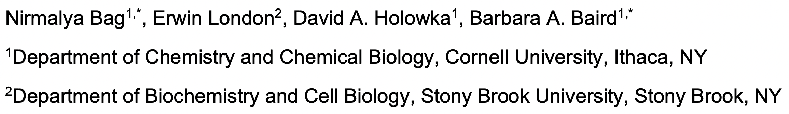
Transbilayer Coupling of Lipids in Cells Investigated by ImFCS
Presented by: Alon Shapiro
Presentation date: Feb. 21, 2022
Paper has not been published or peer reviewed yet

Slide 2
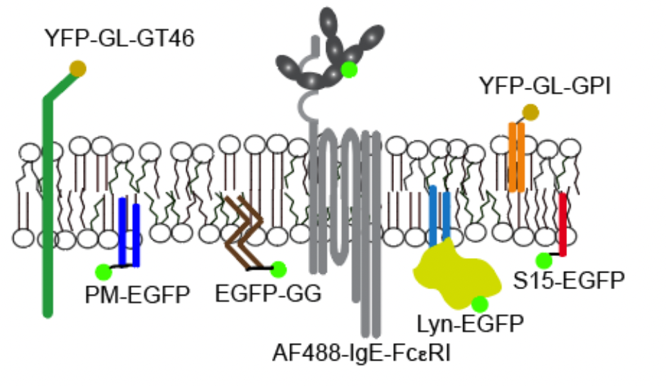
General intro – improve titles, in biological terms
PM composition (receptors, sensors, channels, ...)
PM functions (Signal transduction, signaling reactions in multiple physiological contexts)
Phase separation (Lo, Ld-like, emerging evidence for it) nanoscopic (lipid rafts)
Explain figure, or not include it.
Avoid acronyms. Explain stuff like Lo Ld

Slide 3
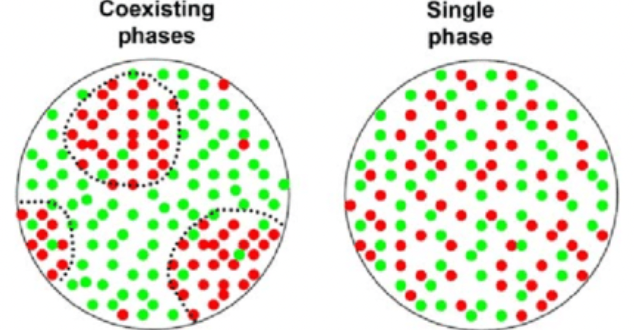
more specific intro
PM asymmetry:
The inner and outer leaflets of the membrane contain different amounts of different types of lipids, which is controlled by transmembrane proteins. Cholesterol flip-flops between leaflets.
GSL, SM primarily on outer leaflet, PE, PS, PIP's localize to inner leaflet. PC and cholesterol present in both leaflets. Common lipids in membranes
The asymmetry between leaflets is important for cellular activity (signal transduction, membrane shape, etc.)
Lo / Ld-preferring lipids, proteins, probes
2 coupling modes: ‘outside-in’ and ‘inside-out’ by interdigitation of components of both leaflets examples
Phase separated
Single phase
Lo labels
Ld

Slide 4
Motivation for this method, compare to existing methods
Currently TB coupling imaging in live cells requires specialized microscopes and difficult sample preparation (FRAP, STED-FCS, SPT,)
results vary widely
Previous evidence for nanoscopic domains in model membranes (cryo-EM, ET, FRET, super-res. microscopy)
Previous evidence examples

Slide 5
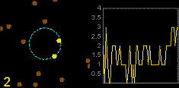
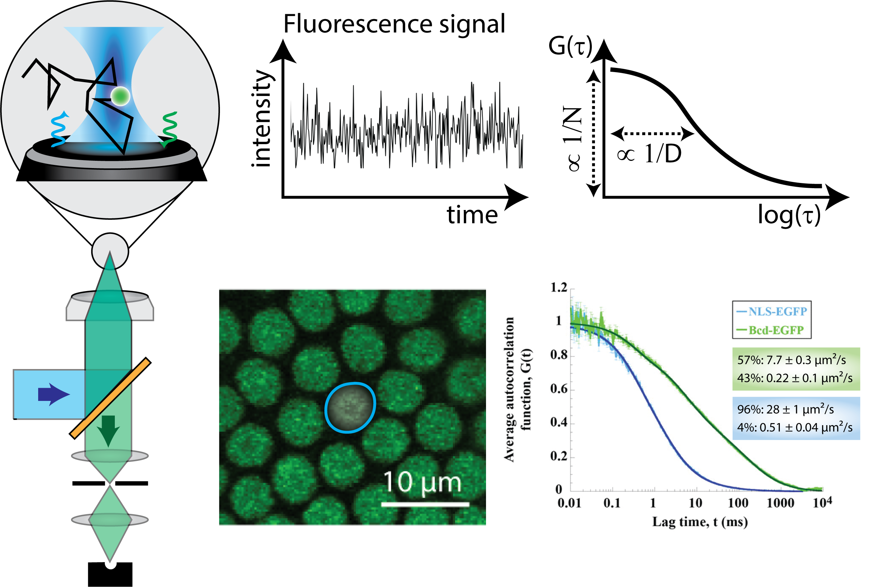
Explain FCS, ImFCS
Confocal FCS
The most conventional FCS setup involves using a confocal microscope, which uses lenses to focus a laser at a single point of the sample, creating a roughly spherical observation volume of a few femtoliters (Mahmood 2020). The small observation volume poses multiple limitations.
For one, many biological processes occur over much larger volumes, which means that a small observation volume heavily limits understanding of the whole system (Guo et al. 2014). Second, diffusion times in biological systems are often long, which means that acquiring sufficient data from a small volume takes a lot of time (Sankaran et al. 2009).
Imaging FCS
Imaging FCS provides a solution to both these problems. By combining a microscope illumination scheme which allows a whole plane of the sample to be viewed at once together with a fast camera sensor, FCS can be done at multiple spatial points at the same time (Ng et al. 2015). This allows for much faster data acquisition. Moreover, it allows for a much larger observation volume (which actually becomes an observation area), which allows for biological processes that occur over larger areas to be observed properly (Guo et al. 2014). This solves the concerns that were raised with confocal FCS, but requires a new sample illumination technique.

Slide 6
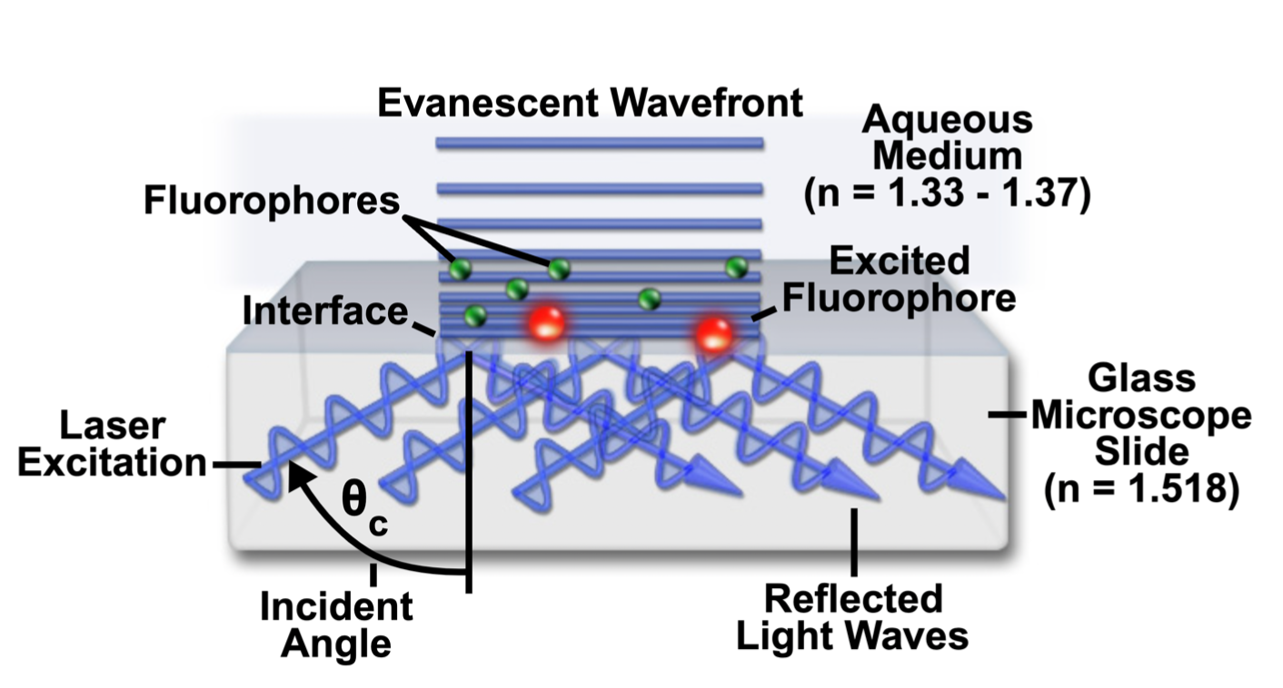
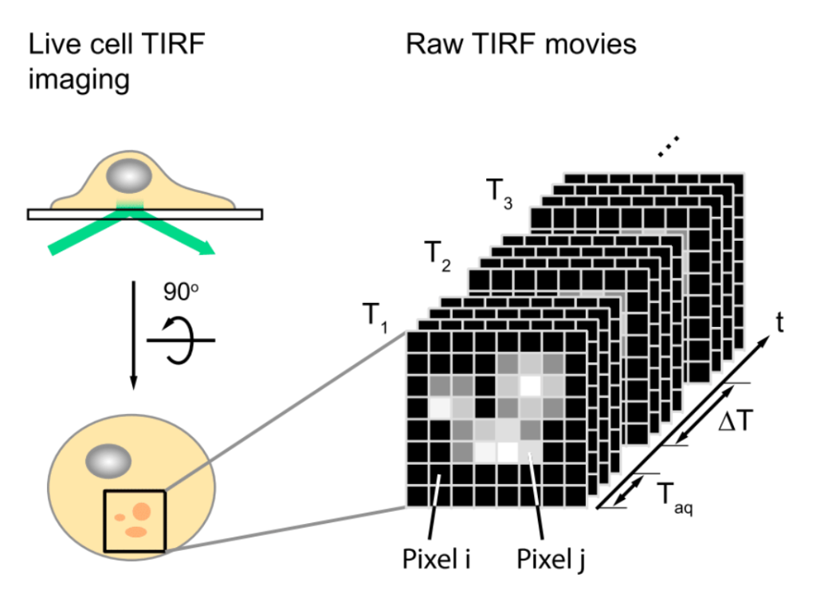
ImFCS on TIR microscope = TIRF

Slide 7
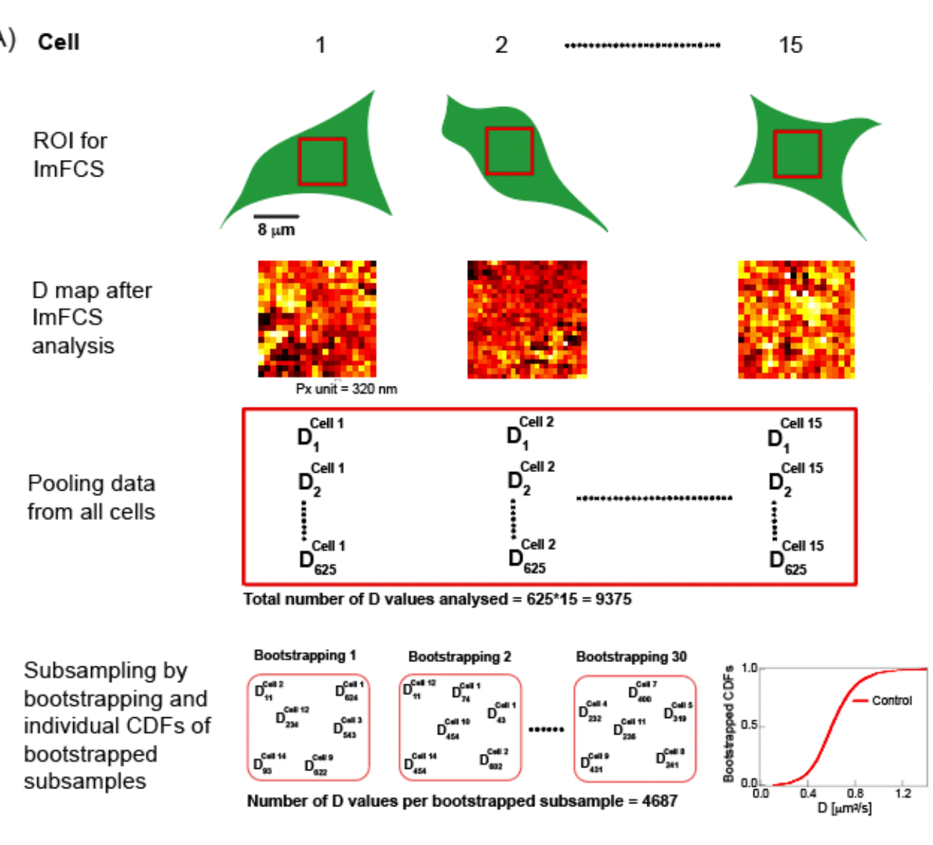
TIRF ImFCS method
Explain figure
Crop figure into multiple smaller
Specifics of their imaging set up
Diffusion of probes in both leaflets of ventral PM with very high precision
Label specific probes with genetically encoded fluorescent proteins or organic fluorophores (proteins or lipids), which are known to preferentially localize to either inner or outer leaflets.
ImFCS provides vast amount of observations which are pooled and subsampled by bootstrapping, yielding CDF’s. explain these

Slide 8
Bootstrapping, CDF’s
Statistical method in which all observed data is aggregated into one set, from which points are then subsampled with replacement.
Using a monte carlo simulation (many iterations), ….

Slide 9
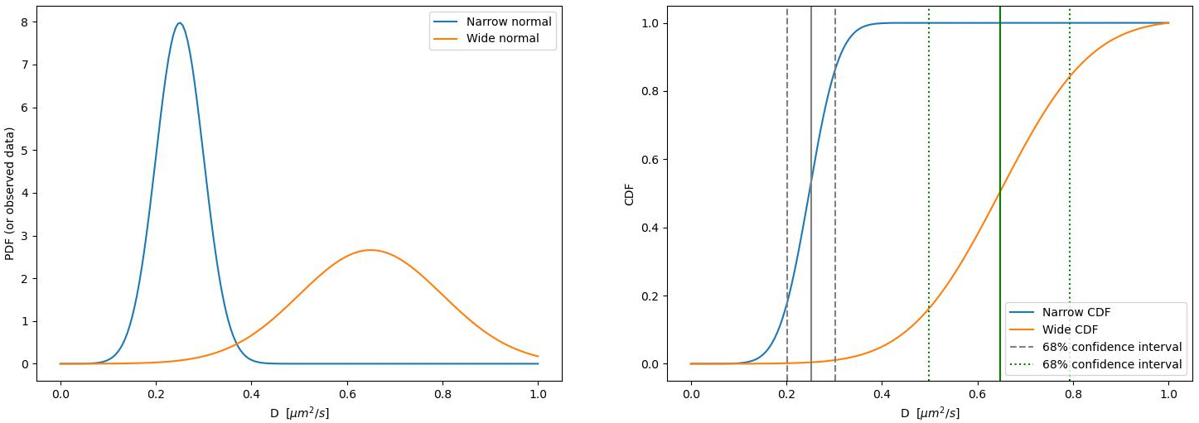
Observed data to CDF

Slide 10
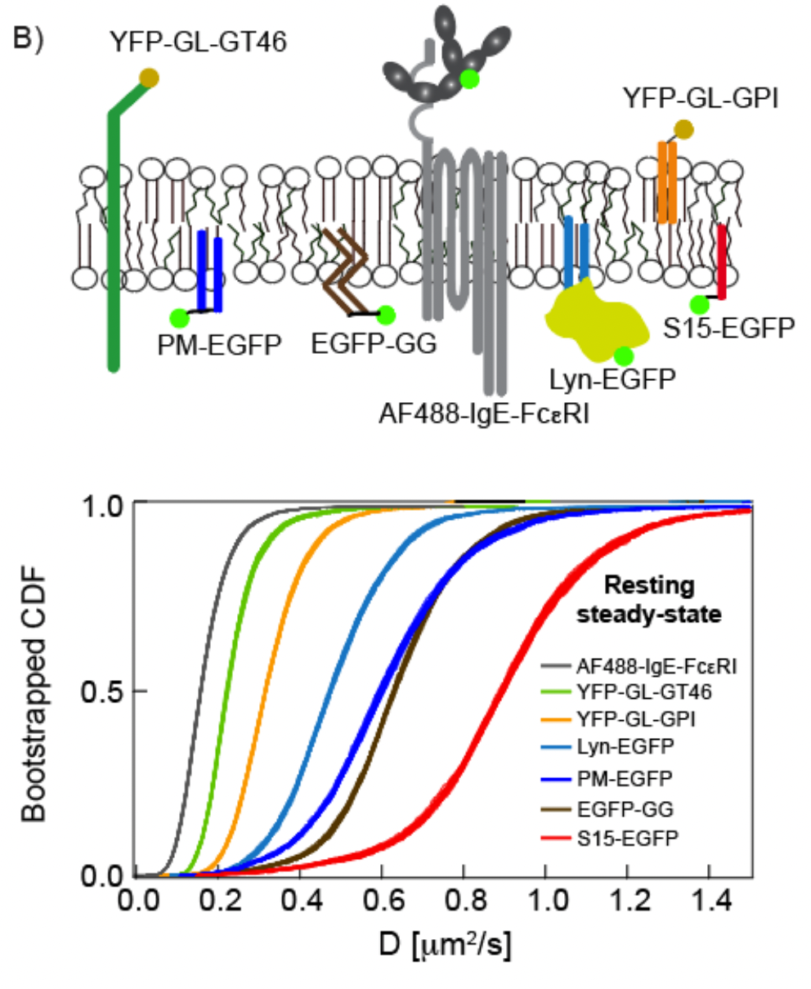
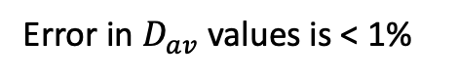
Link CDF’s to figure above (inner probe, outer probe)
Error in $D_{av}$ values is < 1%

Slide 11
Method demonstration on 2 well-established model systems for TB interactions
(Look at outside-in coupling mode by measuring diffusional changes of 2 inner-leaflet probes PM-EGFP (Lo-preferring) and EGFP-GG (Ld-preferring)
1. Ag crosslinking of transmembrane IgE-FcεRI
2. Antibody (Ab)-crosslinking of glycosphingolipid complex CTxB-GM1
Explain what these pathways are

Slide 12
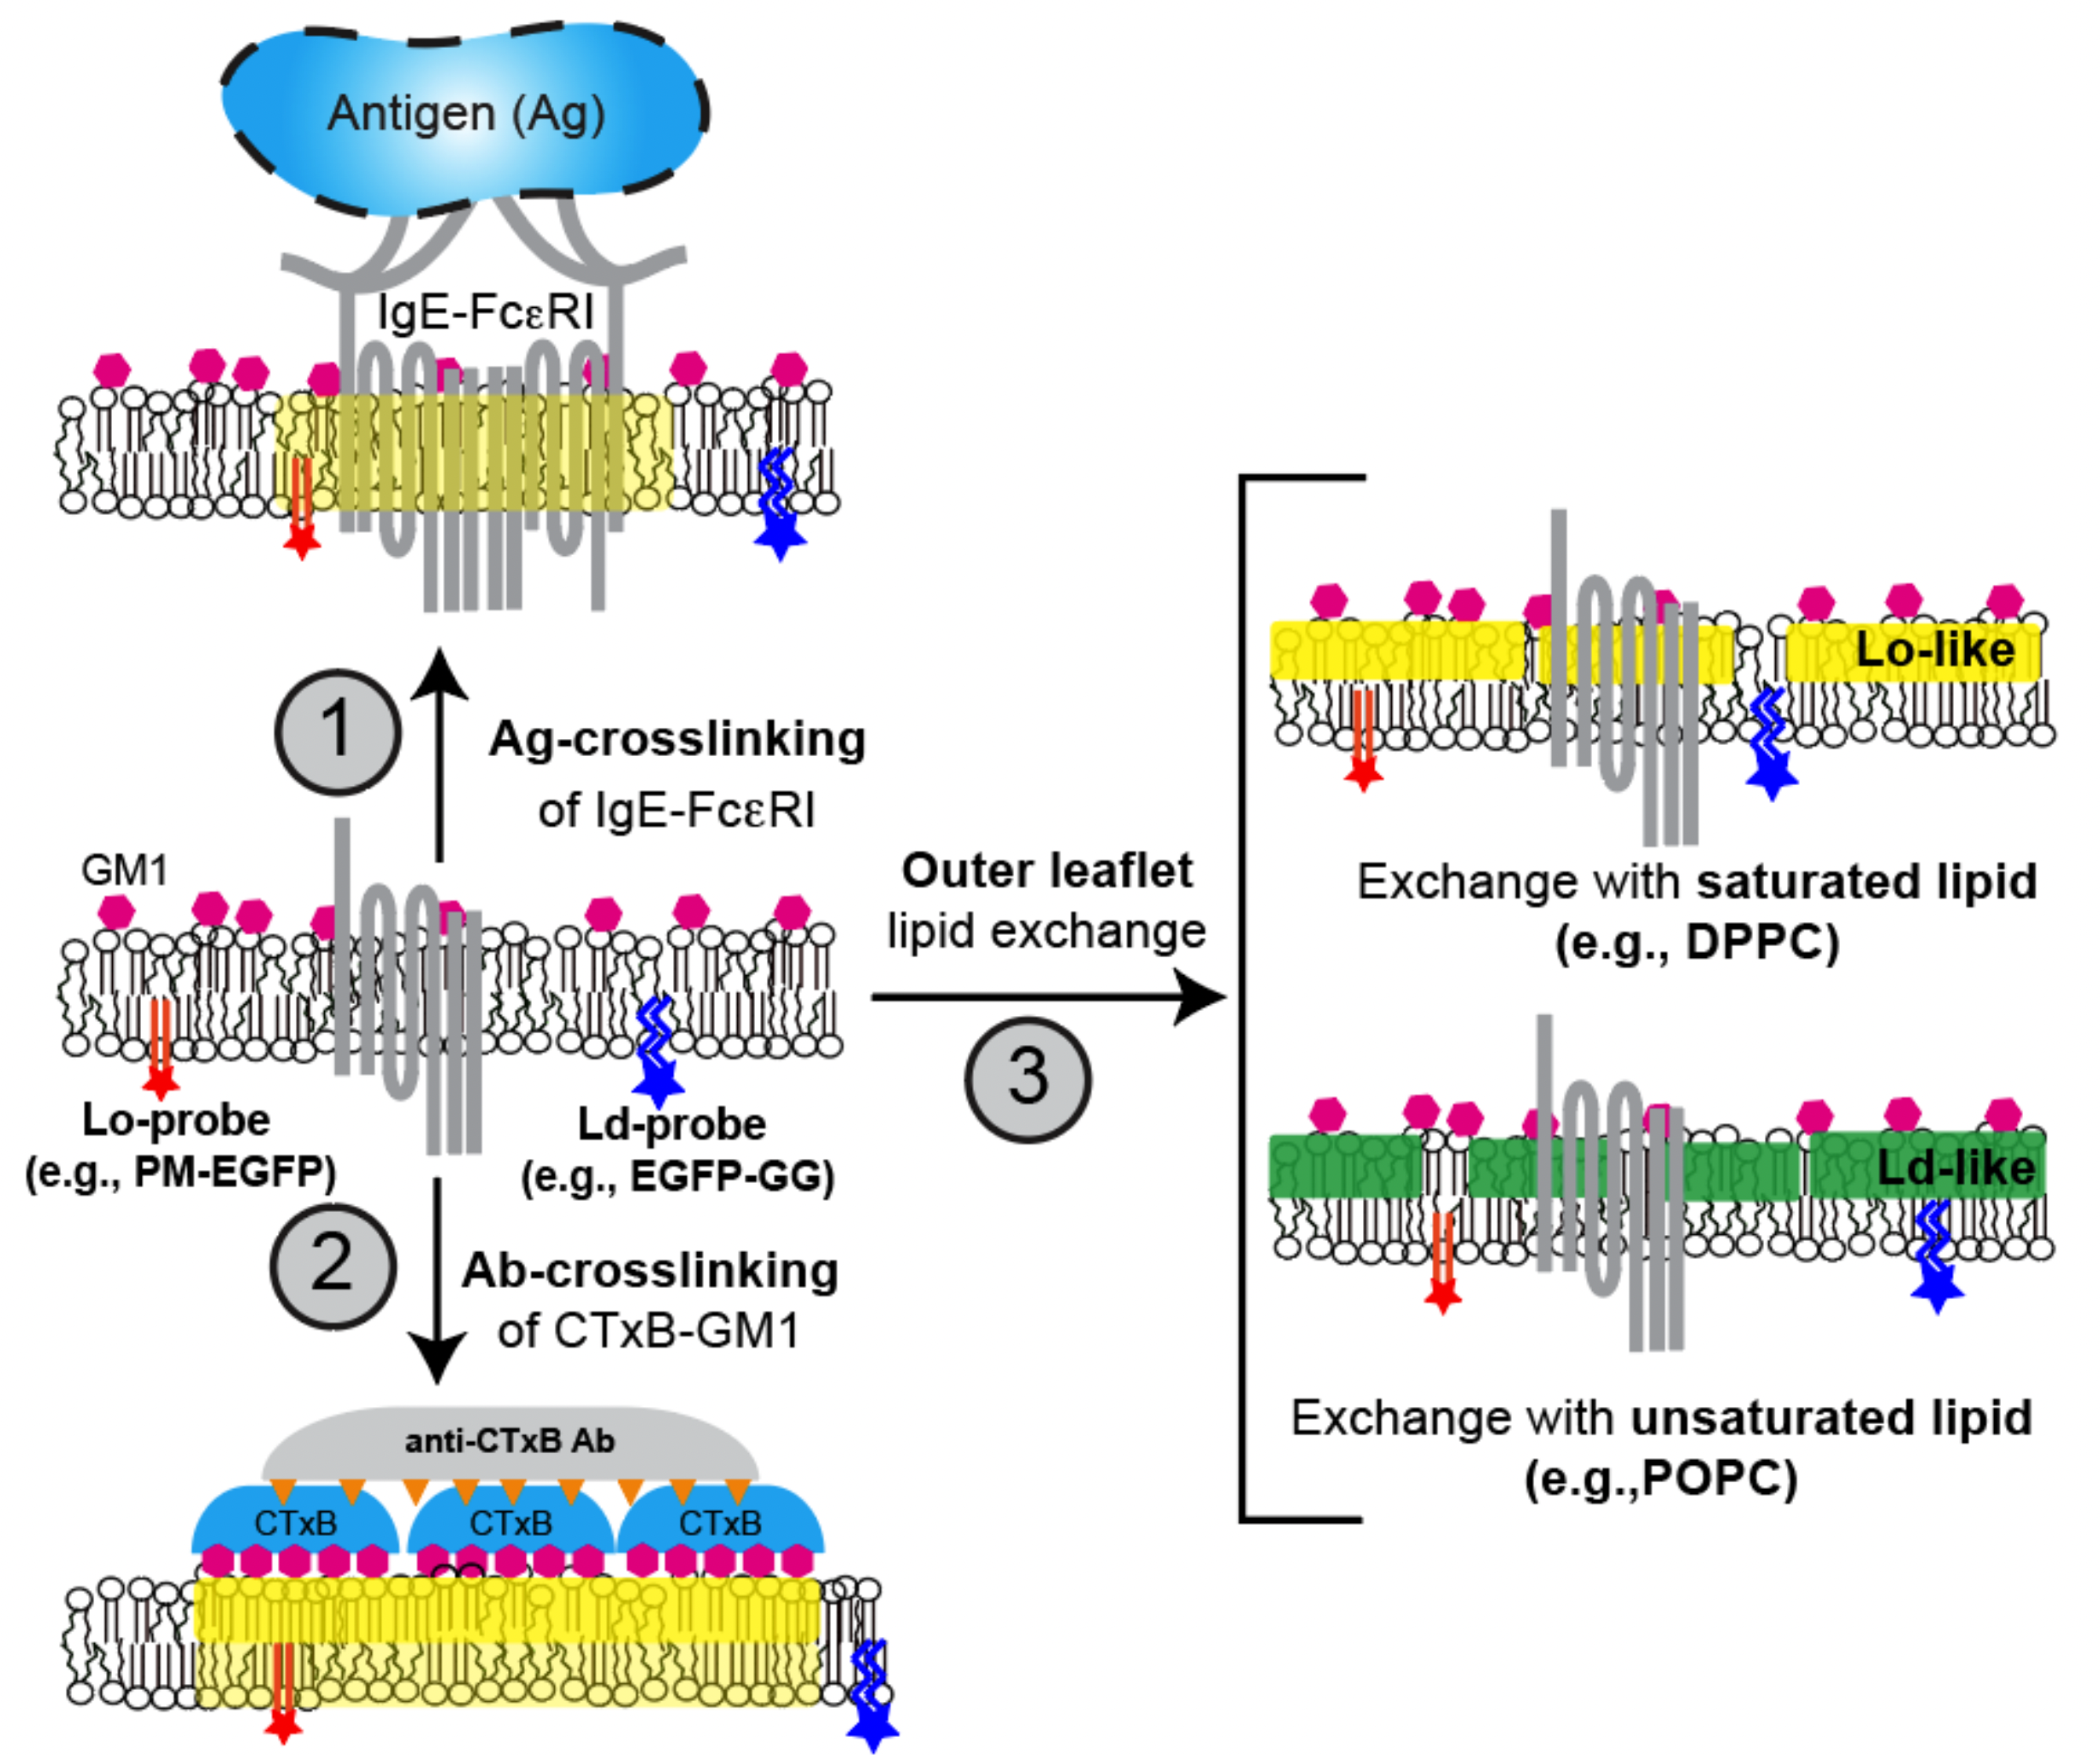
Explain 1. Ag crosslinking of transmembrane IgE-FcεRI

Slide 13
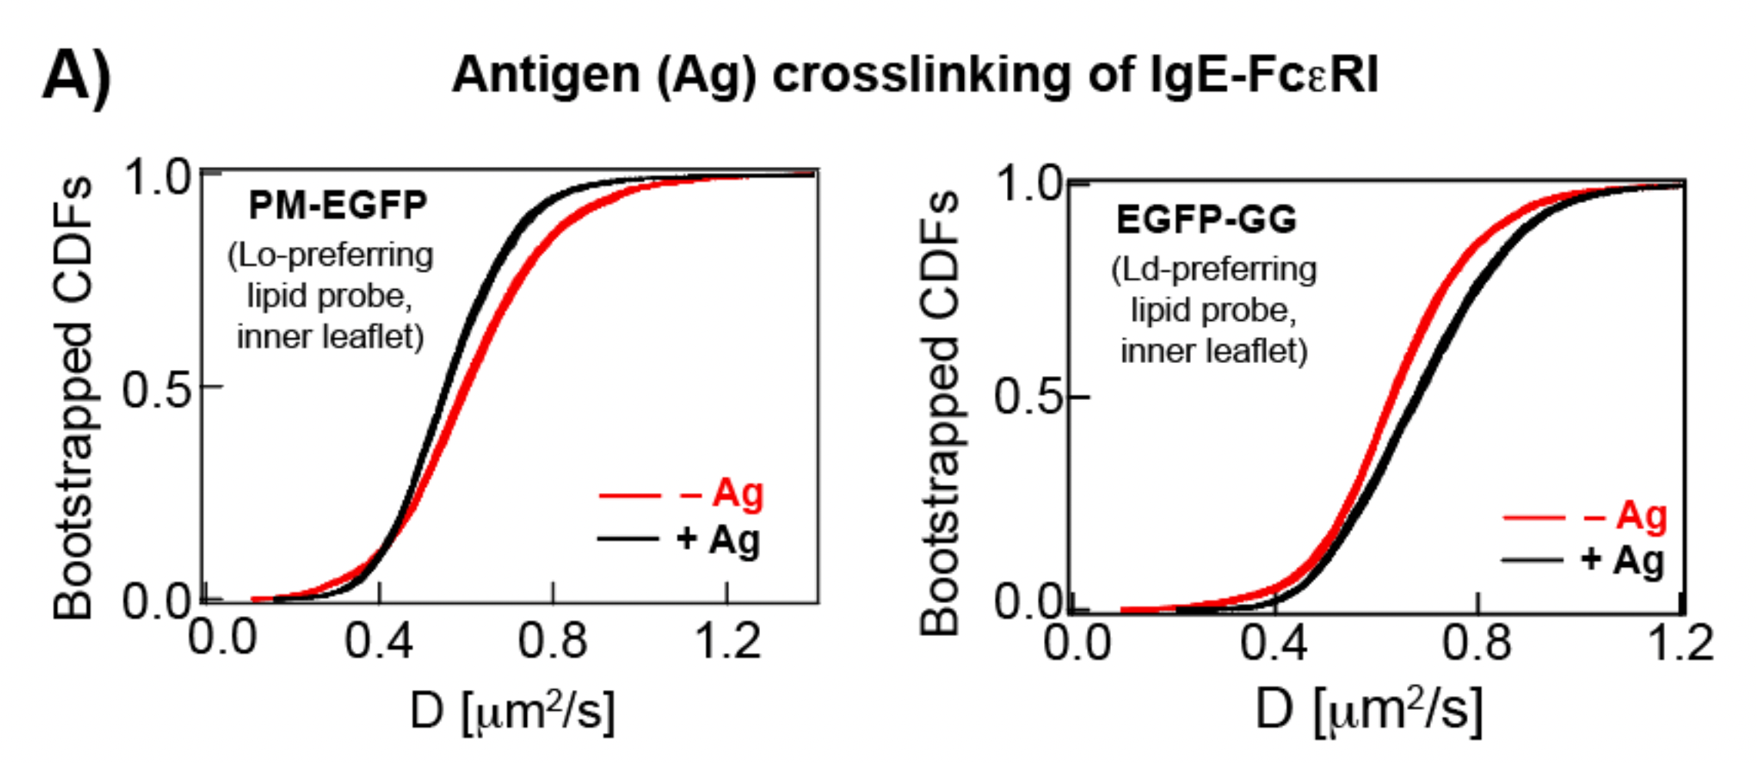
Ag crosslinking of transmembrane IgE-FcεRI
Lo-preferring slows down
Ld-preferring speeds up
Observed Lo-preferring probes cluster around receptor
Conclusion:
Lo-like phase stabilization around clustered receptor
Ld-like probes can diffuse faster in absence of Lo-like probes

Slide 14
Explain Antibody (Ab)-crosslinking of glycosphingolipid complex CTxB-GM1

Slide 15
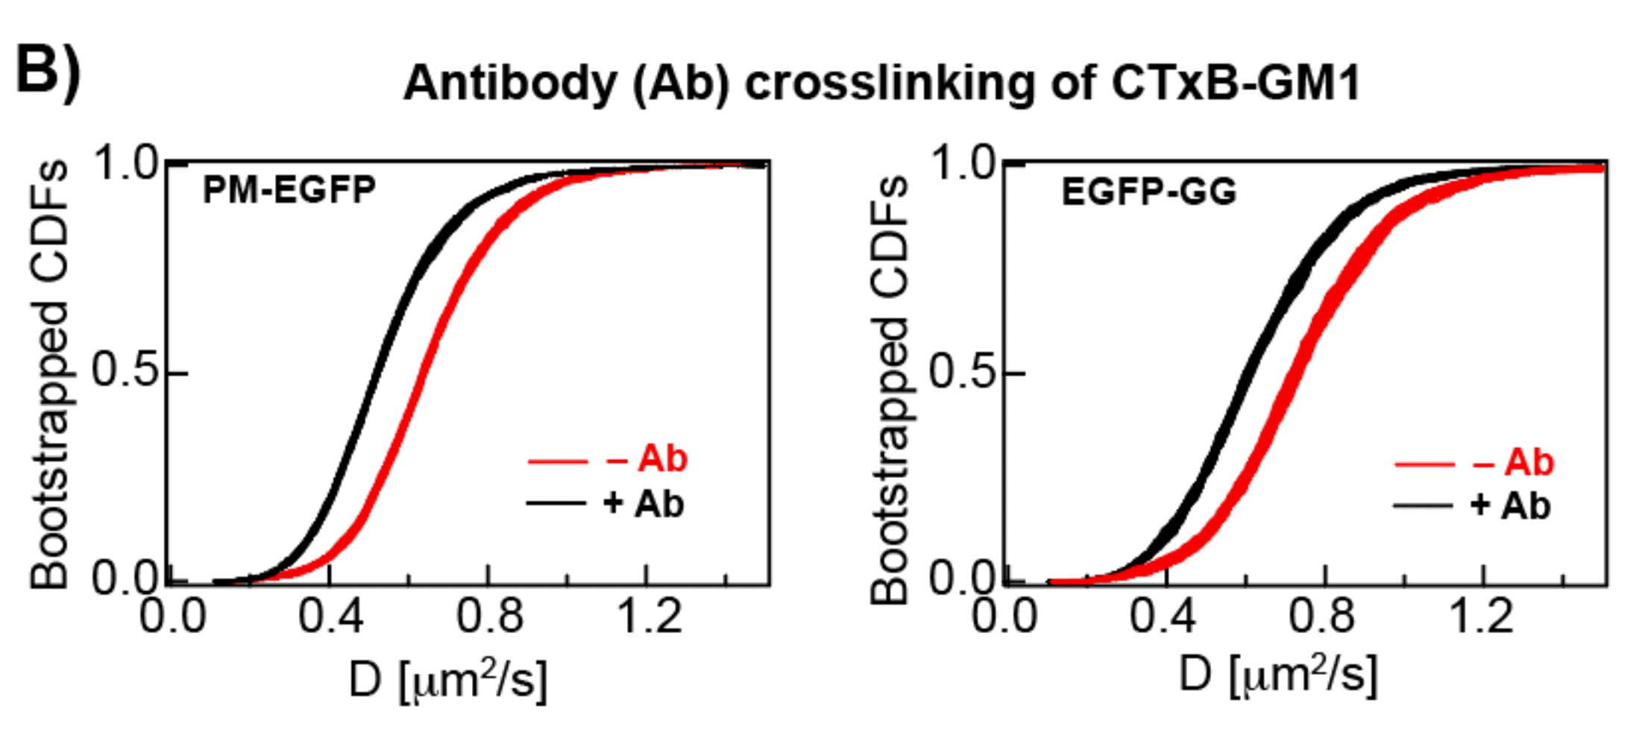
Antibody (Ab)-crosslinking of glycosphingolipid complex CTxB-GM1
Lo-preferring slows down
Ld-preferring also slows down
Lo-like domain stabilization on outer leaflet
Observed no probe clustering on inner leaflet
Conclusion:
Differences may be due to mediator of TM coupling (lipids vs. TM proteins)
Could be actin-engagement, effects of membrane curvature…
Ab-crosslinking of CTxB-GM1 globally affects inner leaflet diffusion properties

Slide 16
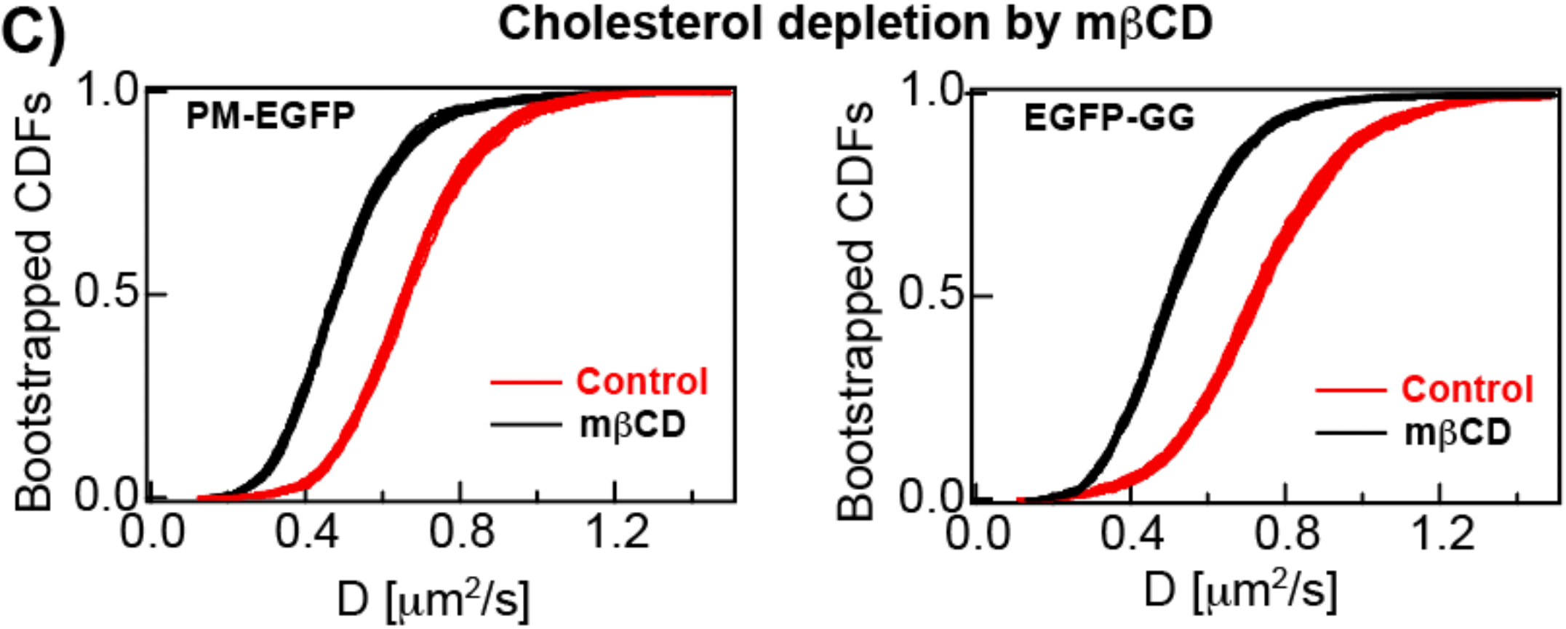
Methods to systematically perturb membrane lipid composition
Cholesterol uptake by mβCD (less free cholesterol in membrane)
Cholesterol makes membrane more rigid, so why do probes slow down?
EXPLAIN FIGURE

Slide 17
Endogenous outer leaflet lipid exchange with exogenous lipids
LEX method that allows exogenous lipids to replace native outer-leaflet lipids up to 80-100% composition, and remains stable for several hours (in live cells).
LEX results? Maybe skip

Slide 18
Drawbacks of this method
cholesterol high flip-flop rate (and other lipids and proteins too)
Existing results are from model membranes which lack a cytoskeleton

Slide 19
Conclusions
First mention again what they did: used TIRF to study D of probes in TB coupling interactions, compared quantitative results to previous results, summarize all results again
Quantitative approach to studying TM coupling with very good statistics, allowing for smaller effects to be observed
Easier sample preparation

Slide 20
What my project is about
Characterize psf
Explain the method for finding the psf (include figures?)
Write protocol for doing ImFCS on TIRF microscope

Slide 21
overview of project
what has been done:
Reading lit., learning how to use software, analyzed previous data
what's left to do:
Image 100nm, 200nm (prelim data), Monday
SLB protocol, image SLB
SLB data to get ‘real’ psf evaluation
Write protocol

